Slide 1

Lesson 1- The Internet and World Wide Web

Slide 2
The Internet

Slide 3
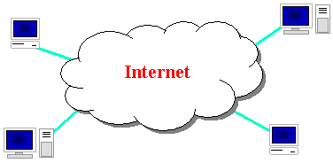
The Internet
a connection of computer networks using the Internet Protocol (IP)
What's the difference between the Internet and the World Wide Web (WWW)?

Slide 4
Brief history
began as a US Department of Defense network called ARPANET (1960s-70s)
initial services: electronic mail, file transfer
opened to commercial interests in late 80s
WWW created in 1989-91 by Tim Berners-Lee
popular web browsers released: Netscape 1994, IE 1995
Amazon.com opens in 1995; Google January 1996

Slide 5
Key aspects of the internet
subnetworks can stand on their own
computers can dynamically join and leave the network
built on open standards; anyone can create a new internet device
lack of centralized control (mostly)
everyone can use it with simple, commonly available software

Slide 6



People and organizations
Internet Engineering Task Force (IETF): internet protocol standards
Internet Corporation for Assigned Names and Numbers (ICANN): decides top-level domain names
World Wide Web Consortium (W3C): web standards

Slide 7
Layered architecture
The internet uses a layered hardware/software architecture (also called the "OSI(Open System Interconnection) model"):
physical layer : devices such as ethernet, coaxial cables, fiber-optic lines, modems
data link layer : basic hardware protocols (ethernet, wifi, DSL PPP)
network / internet layer : basic software protocol (IP)
transport layer : adds reliability to network layer (TCP, UDP)
application layer : implements specific communication for each kind of program (HTTP, POP3/IMAP, SSH, FTP)

Slide 8
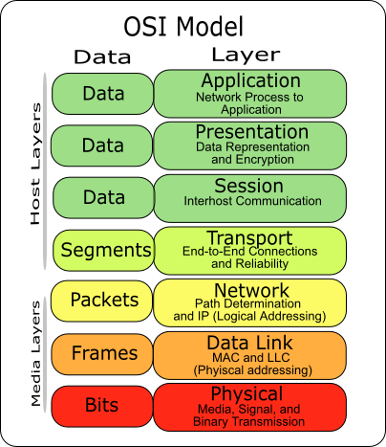
Layered architecture (Cont.)

Slide 9
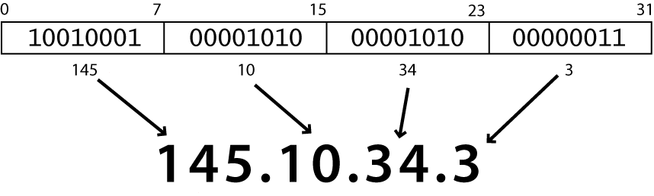
Internet Protocol (IP)
a simple protocol for attempting to send data between two computers
each device has a 32-bit IP address written as four 8-bit numbers (0-255)
find out your internet IP address: whatismyip.com
find out your local IP address: in a terminal, type: ipconfig (Windows) or ifconfig (Mac/Linux)

Slide 10
Transmission Control Protocol (TCP)
adds multiplexing, guaranteed message delivery on top of IP
multiplexing: multiple programs using the same IP address
port: a number given to each program or service
port 80: web browser (port 443 for secure browsing)
port 25: email
port 22: ssh
port 5190: AOL Instant Messenger
some programs (games, streaming media programs) use simpler UDP protocol instead of TCP

Slide 11
The World Wide Web (WWW)

Slide 12
Web servers and browsers
web server: software that listens for web page requests
Apache
Microsoft Internet Information Server (IIS) (part of Windows)
web browser: fetches/displays documents from web servers Firefox web browser
Mozilla Firefox
Microsoft Internet Explorer (IE)
Apple Safari
Google Chrome
Opera

Slide 13
Domain Name System (DNS)
a set of servers that map written names to IP addresses
Example: www.cs.washington.edu → 128.208.3.88
many systems maintain a local cache called a hosts file
Windows: C:\Windows\system32\drivers\etc\hosts
Mac: /private/etc/hosts
Linux: /etc/hosts

Slide 14

Uniform Resource Locator (URL)
an identifier for the location of a document on a web site
a basic URL:
upon entering this URL into the browser, it would:
ask the DNS server for the IP address of www.aw-bc.com
connect to that IP address at port 80
ask the server to GET /info/regesstepp/index.html
display the resulting page on the screen

Slide 15
More advanced URLs
anchor: jumps to a given section of a web pagehttp://www.textpad.com/download/index.html#downloads
fetches index.html then jumps down to part of the page labeled downloads
port: for web servers on ports other than the default 80http://www.cs.washington.edu:8080/secret/money.txt
query string: a set of parameters passed to a web programhttp://www.google.com/search?q=miserable+failure&start=10
parameter q is set to "miserable+failure"
parameter start is set to 10

Slide 16
Hypertext Transport Protocol (HTTP)
the set of commands understood by a web server and sent from a browser
some HTTP commands (your browser sends these internally):
GET filename : download
POST filename : send a web form response
PUT filename : upload

Slide 17
HTTP error codes
when something goes wrong, the web server returns a special "error code" number to the browser, possibly followed by an HTML document
common error codes:
Number | Meaning
200 | OK
301-303 | page has moved (permanently or temporarily)
403 | you are forbidden to access this page
404 | page not found
500 | internal server error

Slide 18
Internet media ("MIME") types
MIME-Multipurpose Internet Mail Extension
sometimes when including resources in a page (style sheet, icon, multimedia object), we specify their type of data
MIME type | file extension
text/html | .html
text/plain | .txt
image/gif | .gif
image/jpeg | .jpg
video/quicktime | .mov
application/octet-stream | .exe

Slide 19
Q & A

